Slide 1

part i image processing
Instructor: dr. nguyen ngoc truong minh
HEAD OF DEPARTMENT OF TELECOMMUNICATIONS
School of electrical engineering, international university (vnu-hcmc)
Ho Chi Minh City, Fall 2025

Slide 2

LECTURE XI – key-point detection
INSTRUCTOR: DR. NGUYEN NGOC TRUONG MINH
HEAD OF DEPARTMENT OF TELECOMMUNICATIONS
SCHOOL OF ELECTRICAL ENGINEERING, INTERNATIONAL UNIVERSITY (VNU-HCMC)
Ho Chi Minh City, Fall 2025

Slide 3

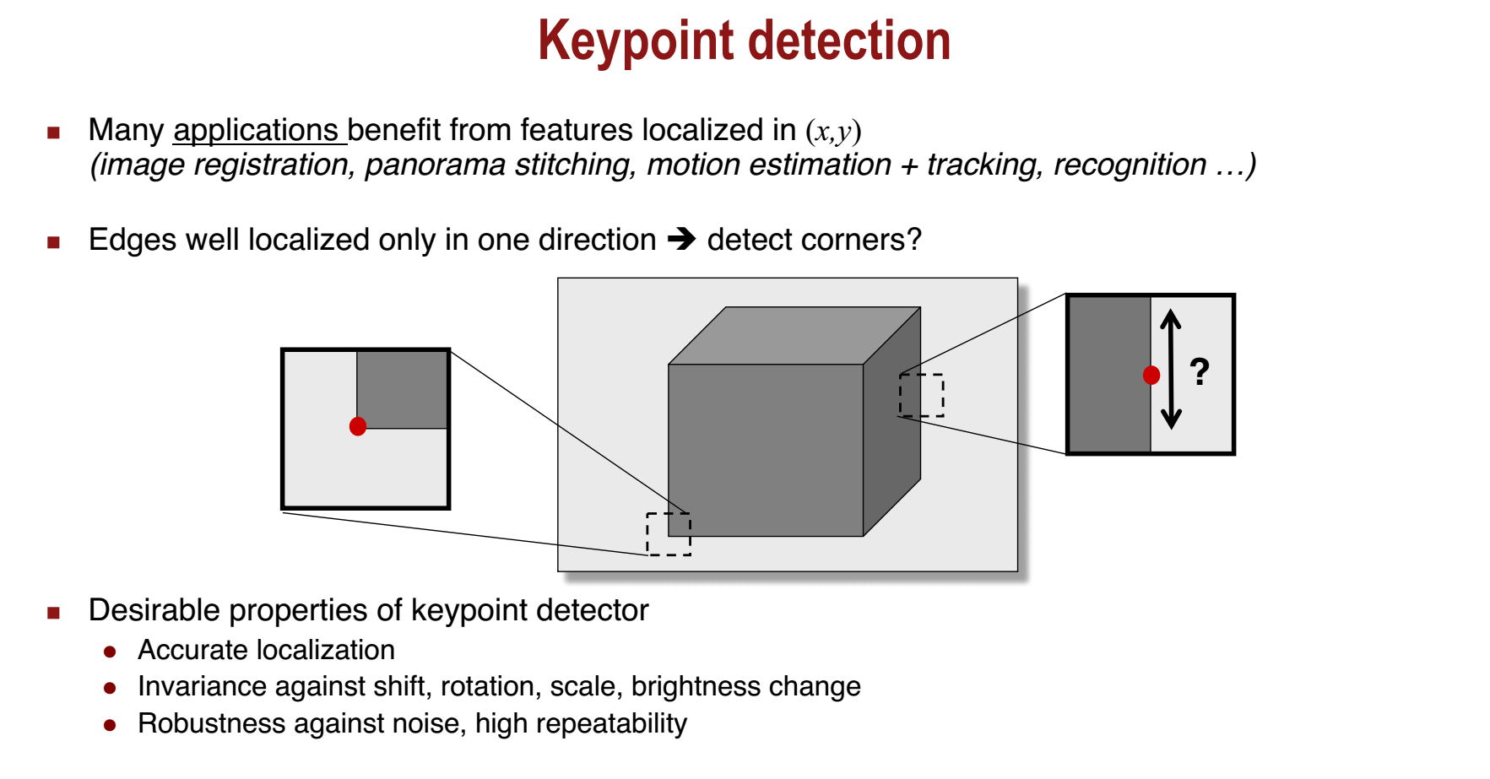
Lecture 11 – Key-point Detection
Image Processing: Dr. Nguyen Ngoc Truong Minh, @2024-2025 International University

Slide 4
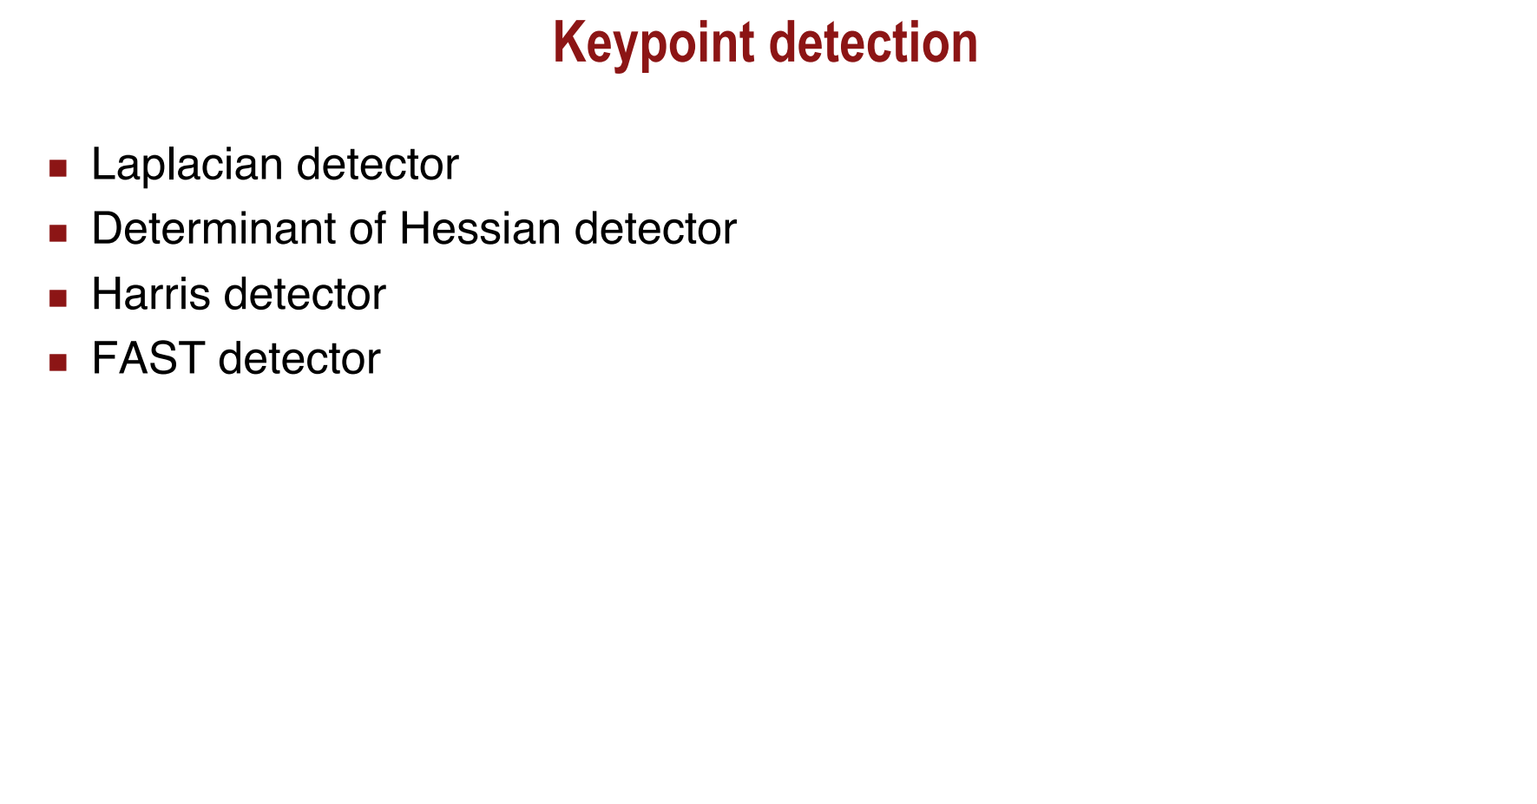
Lecture 11 – Key-point Detection
Image Processing: Dr. Nguyen Ngoc Truong Minh, @2024-2025 International University

Slide 5
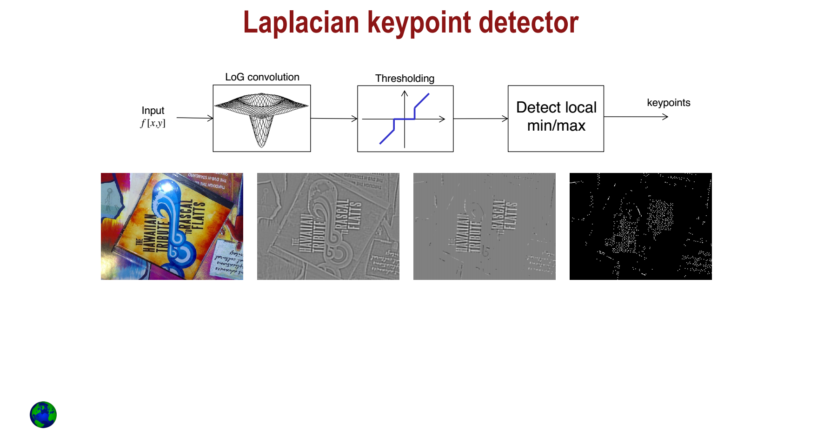
Lecture 11 – Key-point Detection
Image Processing: Dr. Nguyen Ngoc Truong Minh, @2024-2025 International University

Slide 6
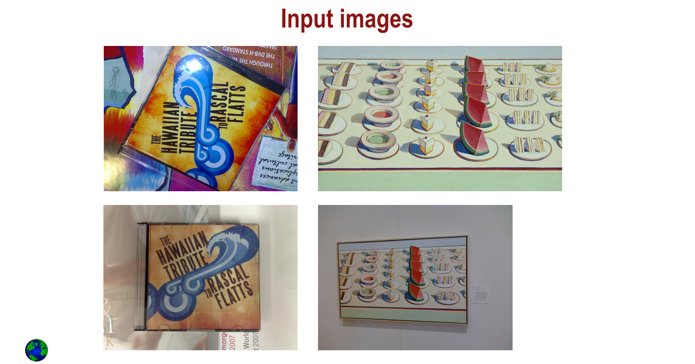
Lecture 11 – Key-point Detection
Image Processing: Dr. Nguyen Ngoc Truong Minh, @2024-2025 International University

Slide 7
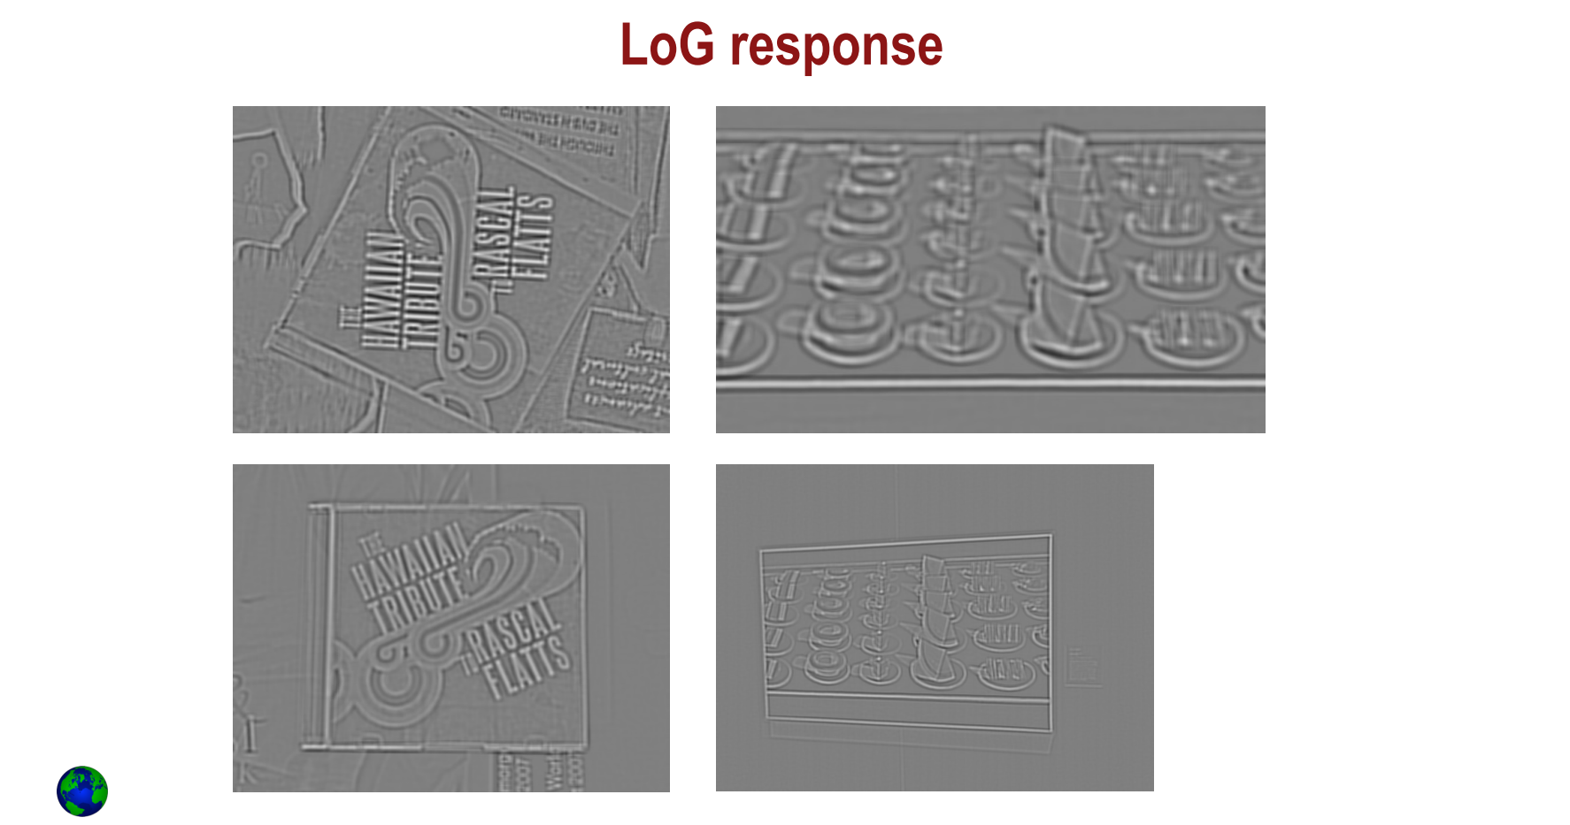
Lecture 11 – Key-point Detection
Image Processing: Dr. Nguyen Ngoc Truong Minh, @2024-2025 International University

Slide 8
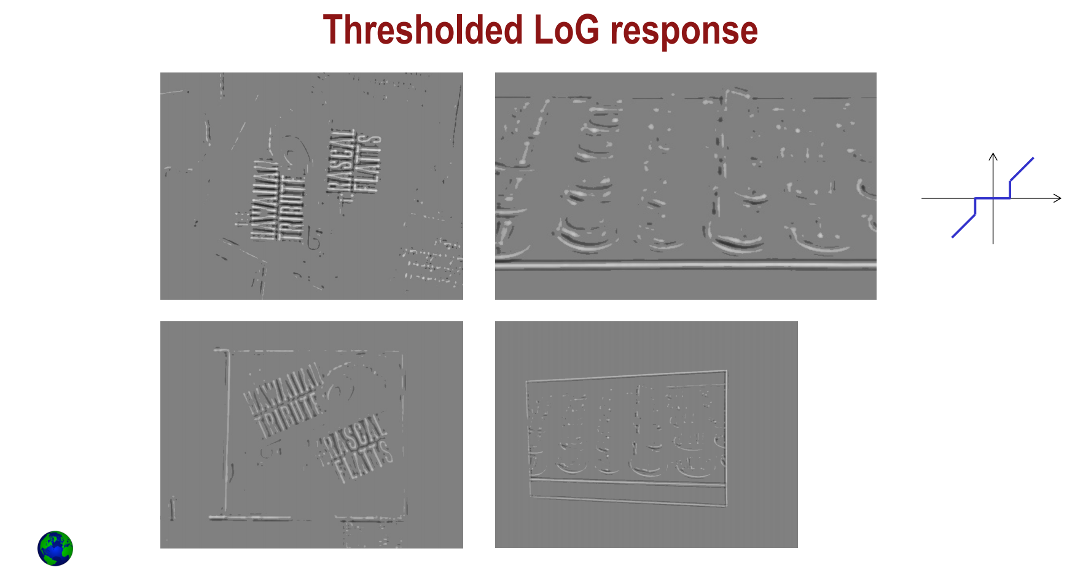
Lecture 11 – Key-point Detection
Image Processing: Dr. Nguyen Ngoc Truong Minh, @2024-2025 International University

Slide 9
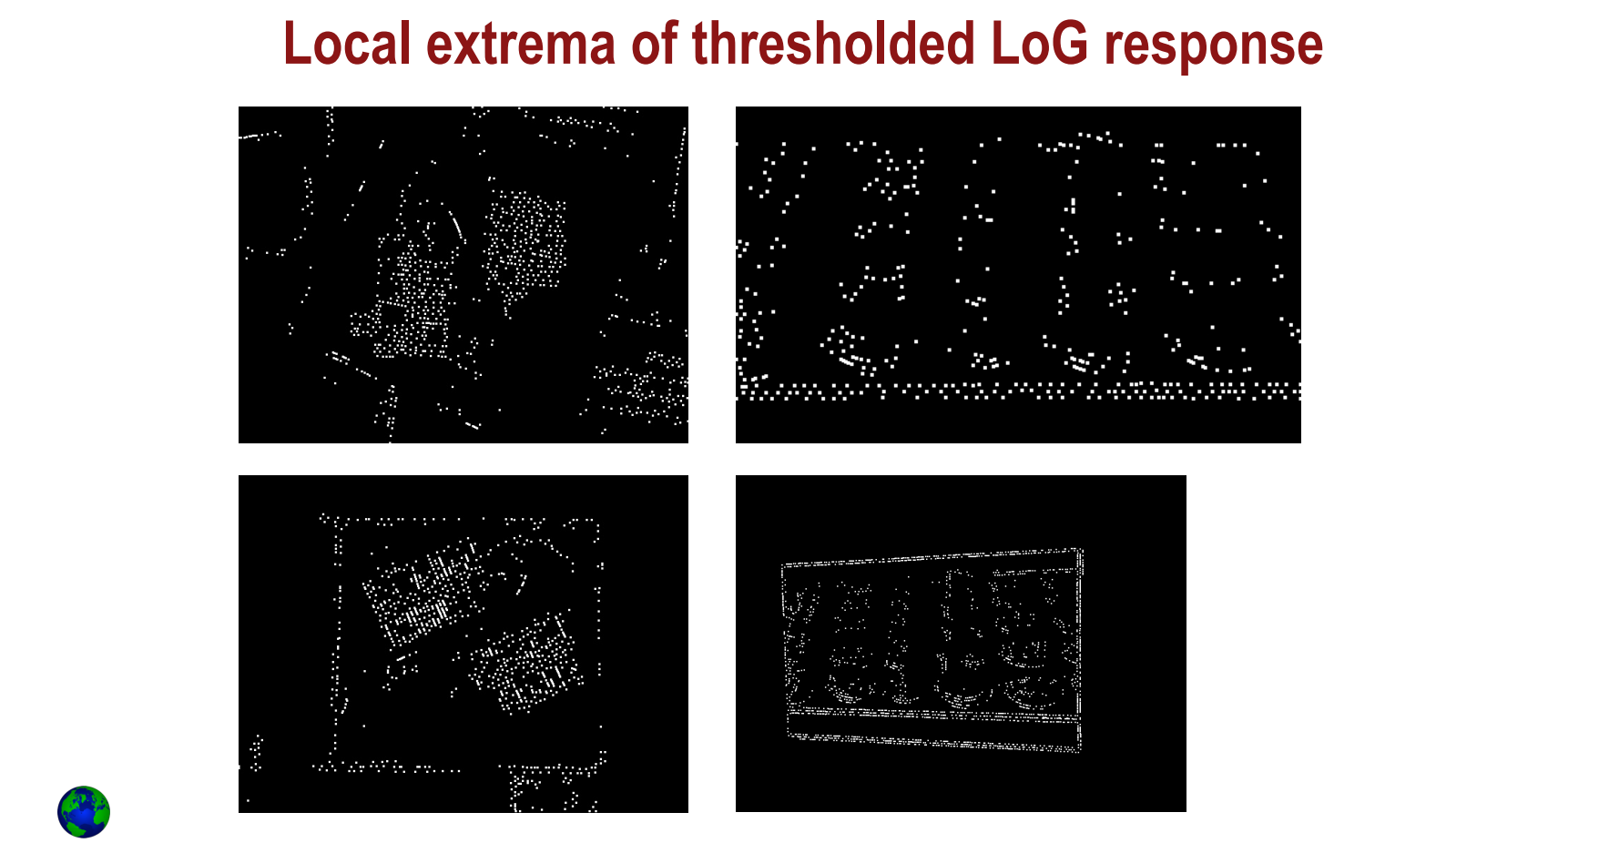
Lecture 11 – Key-point Detection
Image Processing: Dr. Nguyen Ngoc Truong Minh, @2024-2025 International University

Slide 10
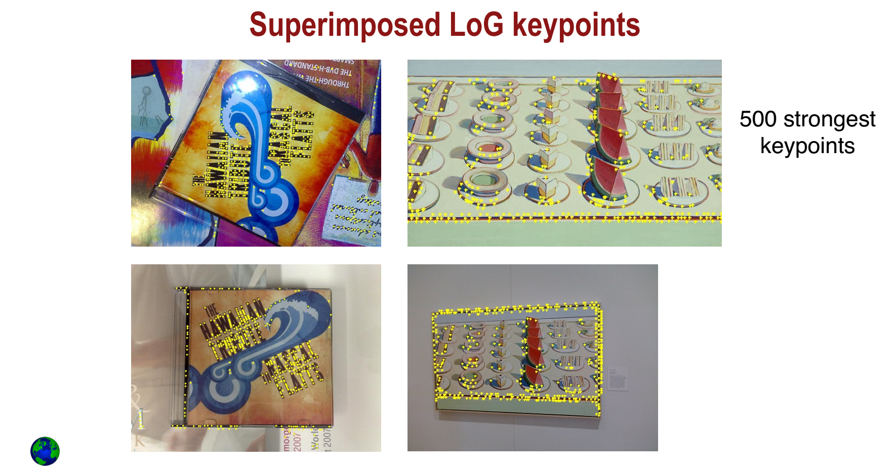
Lecture 11 – Key-point Detection
Image Processing: Dr. Nguyen Ngoc Truong Minh, @2024-2025 International University

Slide 11
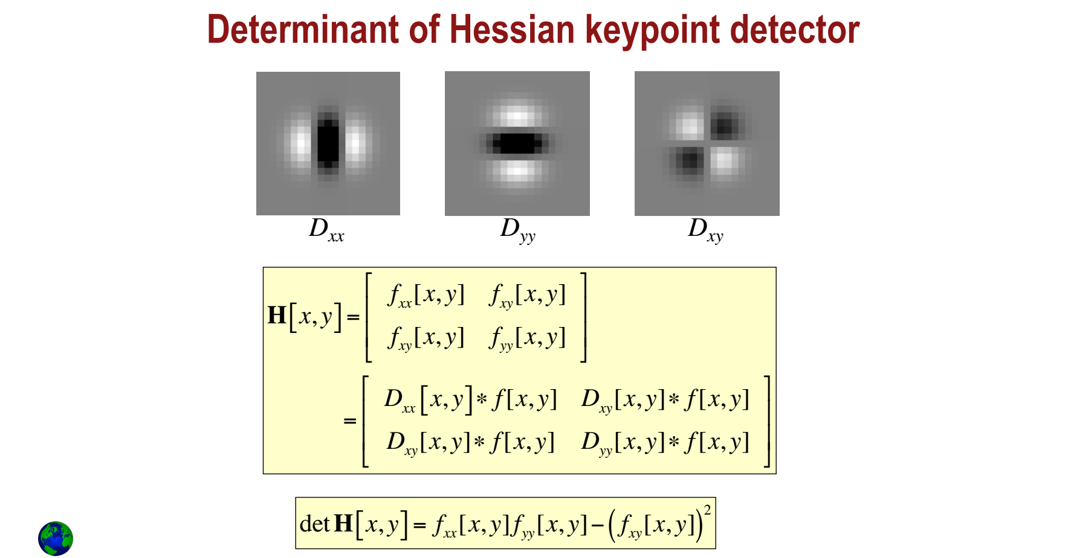
Lecture 11 – Key-point Detection
Image Processing: Dr. Nguyen Ngoc Truong Minh, @2024-2025 International University

Slide 12

Lecture 11 – Key-point Detection
Image Processing: Dr. Nguyen Ngoc Truong Minh, @2024-2025 International University

Slide 13
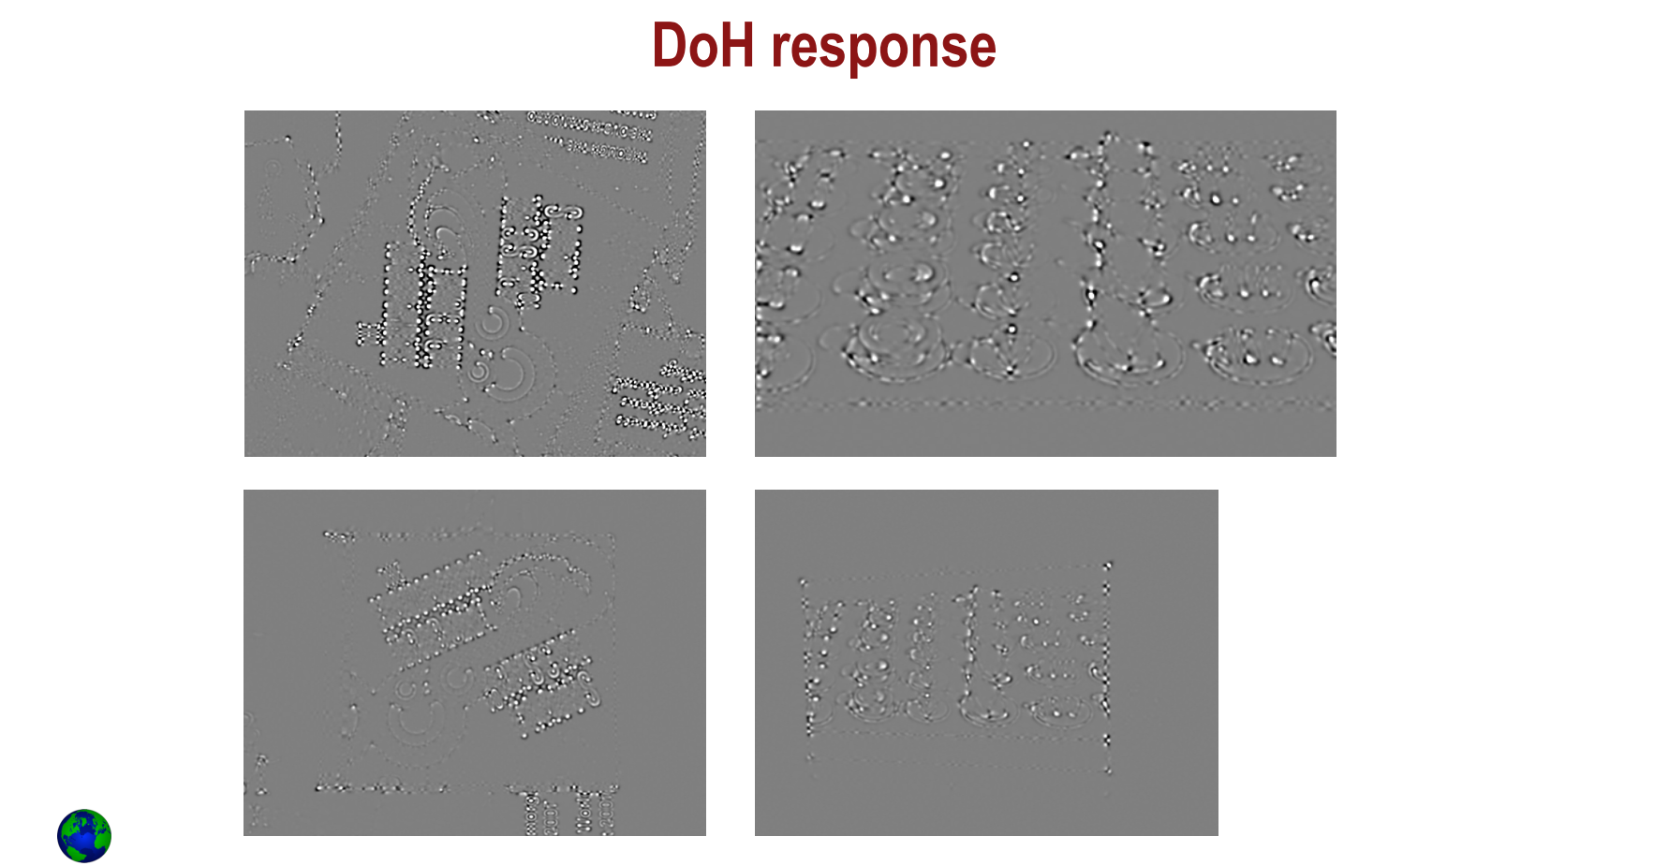
Lecture 11 – Key-point Detection
Image Processing: Dr. Nguyen Ngoc Truong Minh, @2024-2025 International University

Slide 14
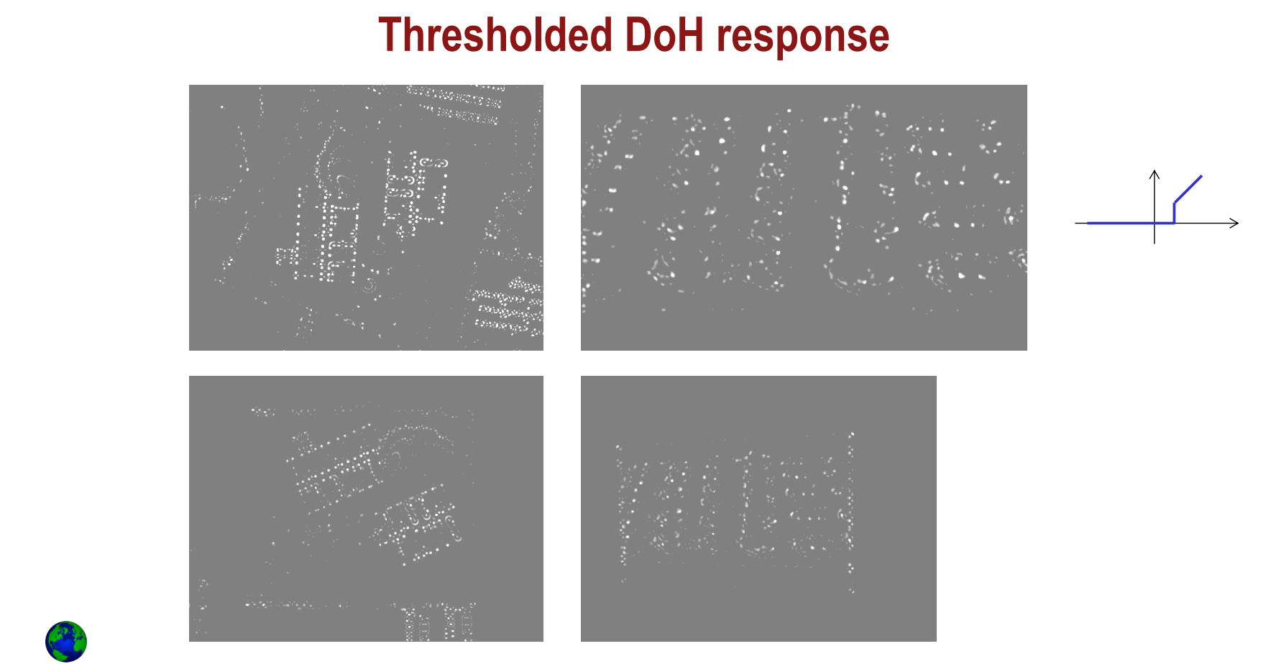
Lecture 11 – Key-point Detection
Image Processing: Dr. Nguyen Ngoc Truong Minh, @2024-2025 International University

Slide 15
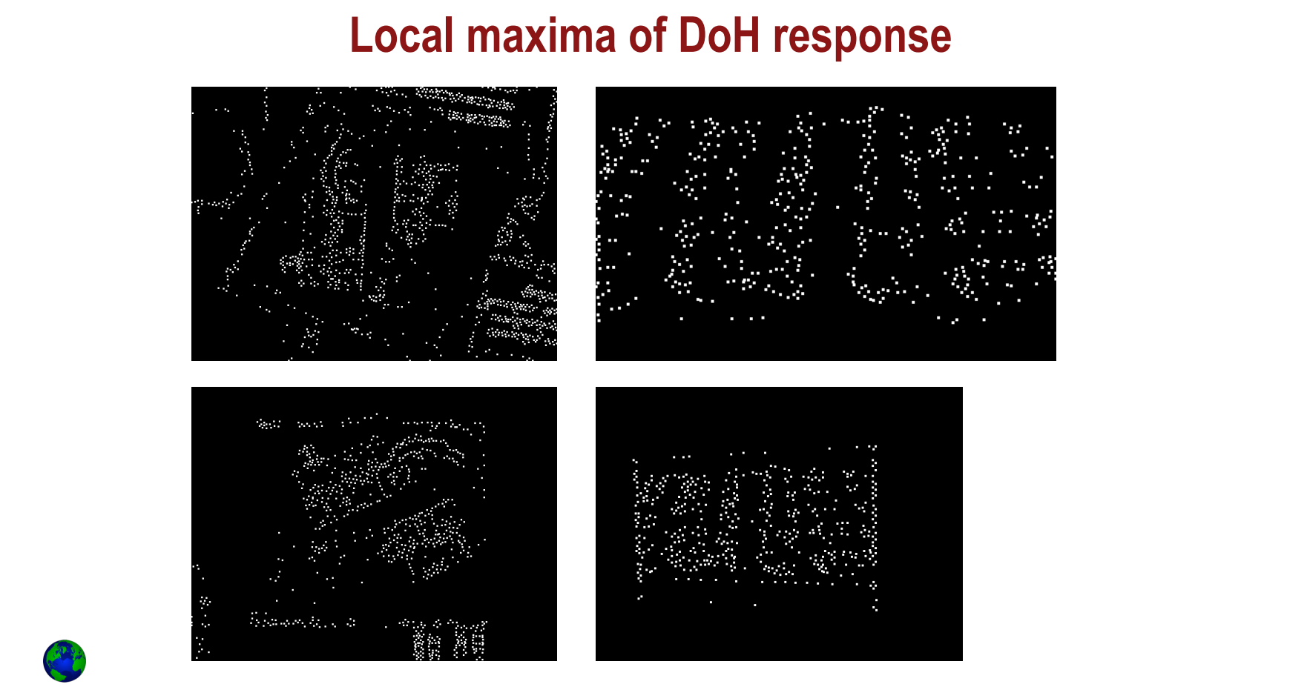
Lecture 11 – Key-point Detection
Image Processing: Dr. Nguyen Ngoc Truong Minh, @2024-2025 International University

Slide 16
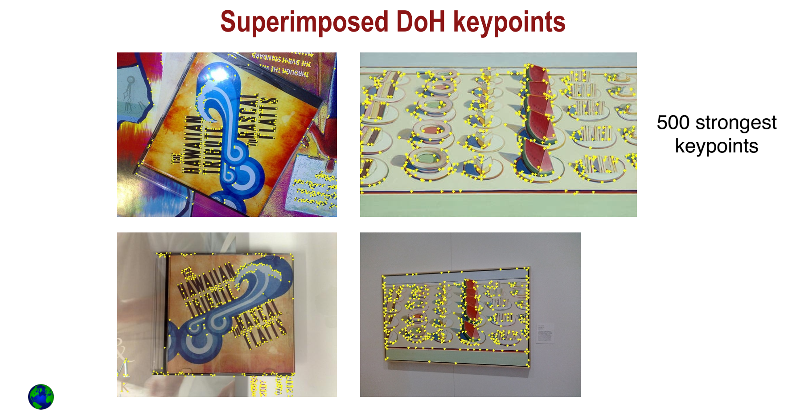
Lecture 11 – Key-point Detection
Image Processing: Dr. Nguyen Ngoc Truong Minh, @2024-2025 International University

Slide 17
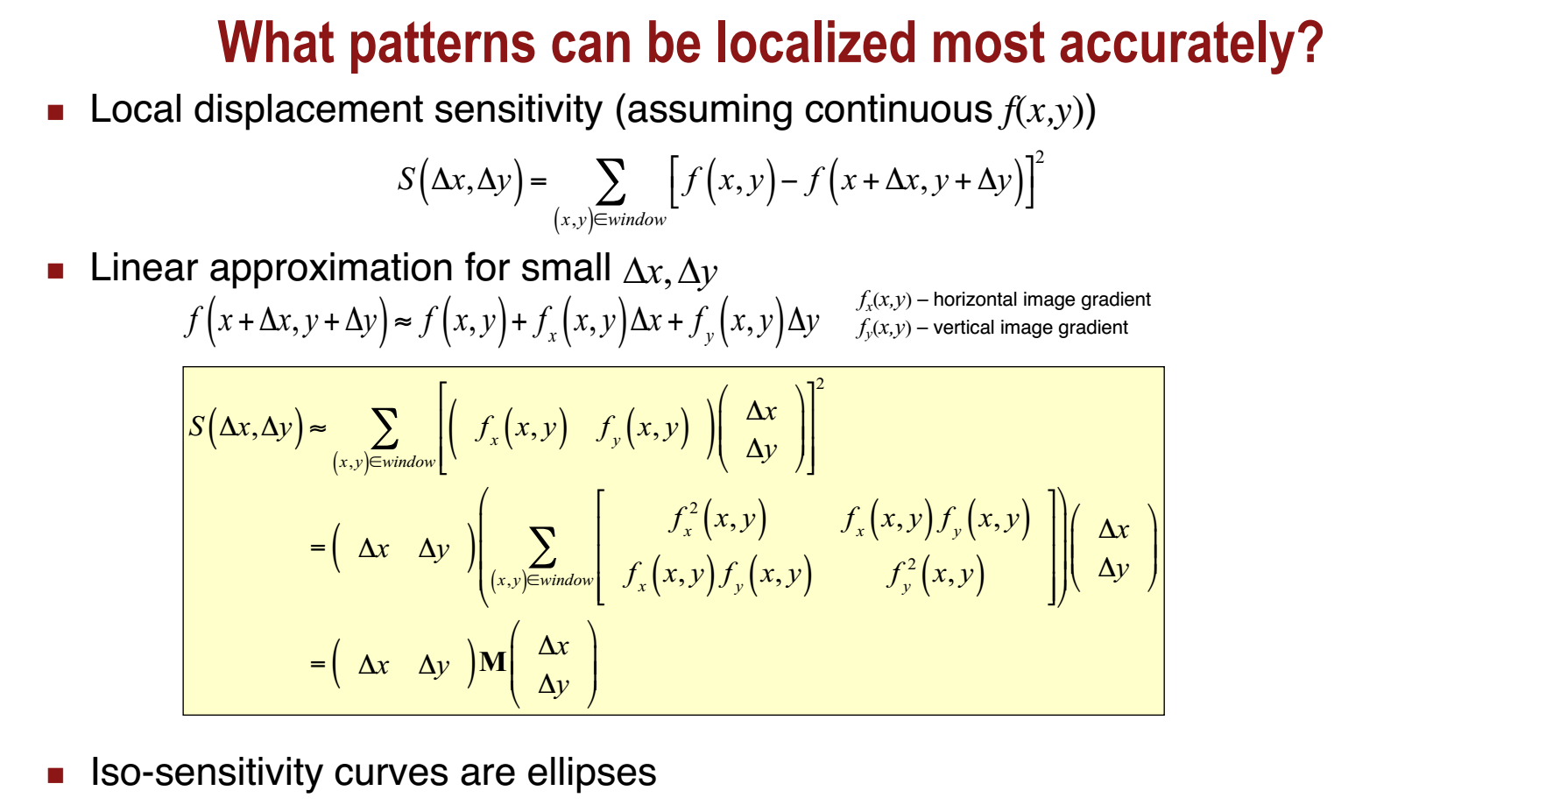
Lecture 11 – Key-point Detection
Image Processing: Dr. Nguyen Ngoc Truong Minh, @2024-2025 International University

Slide 18
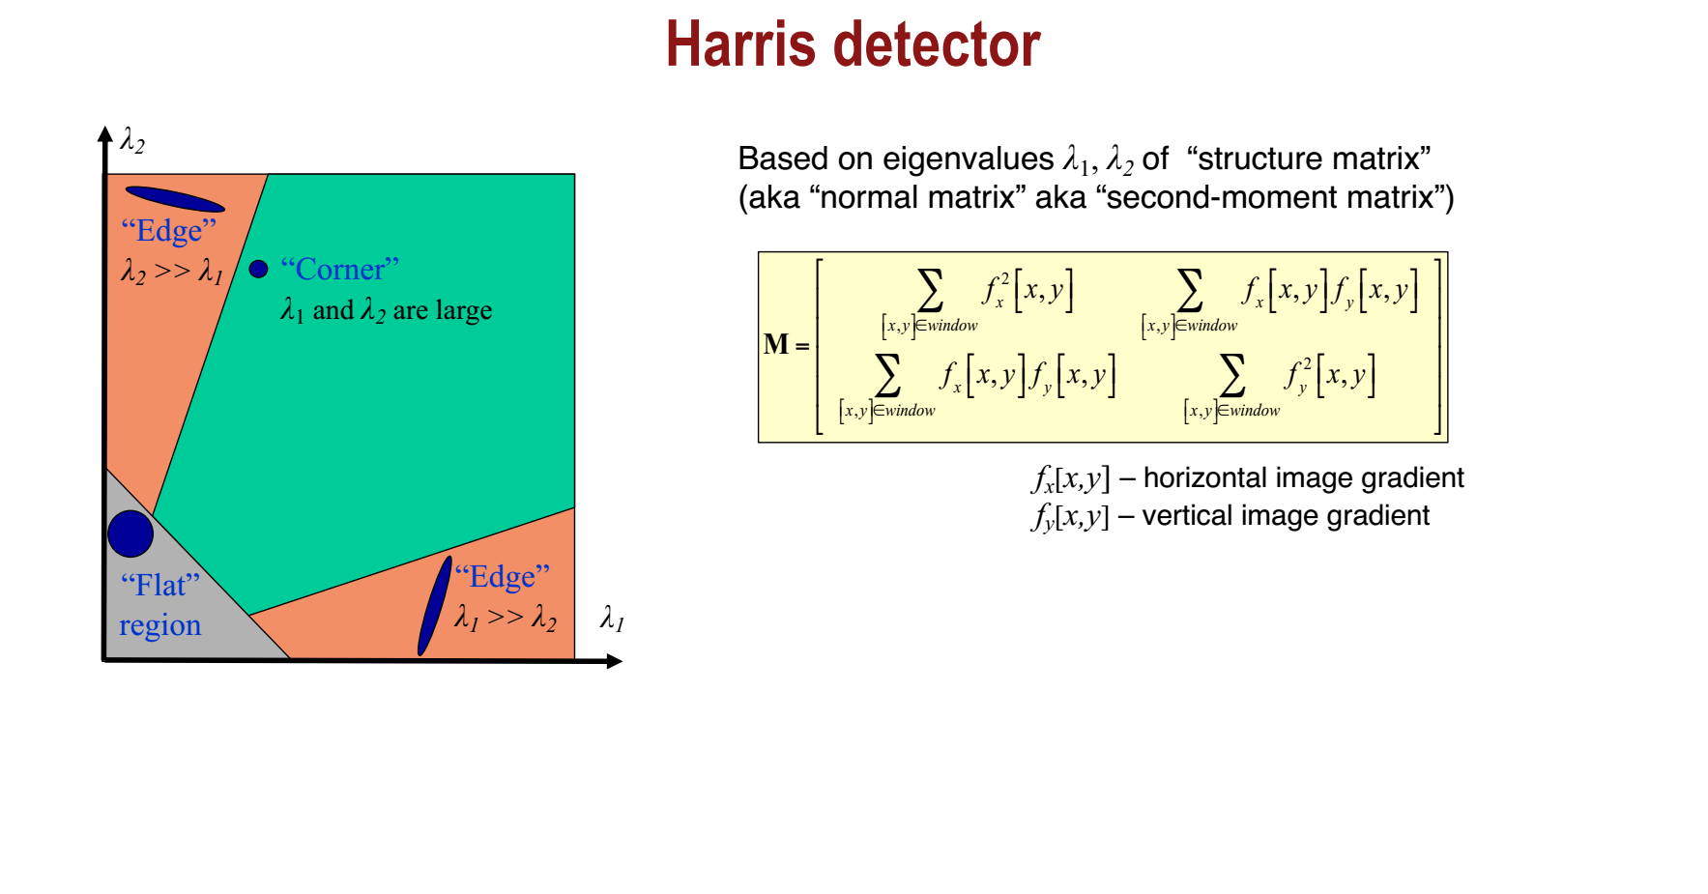
Lecture 11 – Key-point Detection
Image Processing: Dr. Nguyen Ngoc Truong Minh, @2024-2025 International University

Slide 19
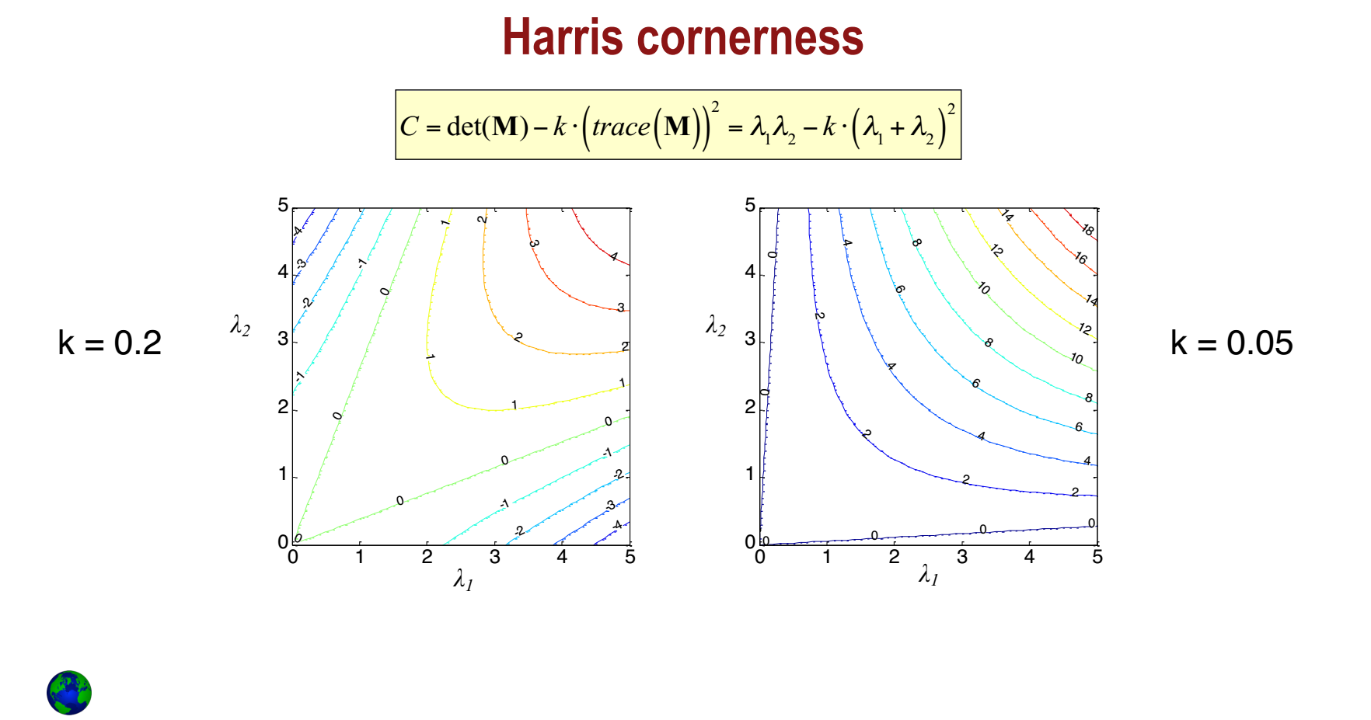
Lecture 11 – Key-point Detection
Image Processing: Dr. Nguyen Ngoc Truong Minh, @2024-2025 International University

Slide 20

Lecture 11 – Key-point Detection
Image Processing: Dr. Nguyen Ngoc Truong Minh, @2024-2025 International University

Slide 21
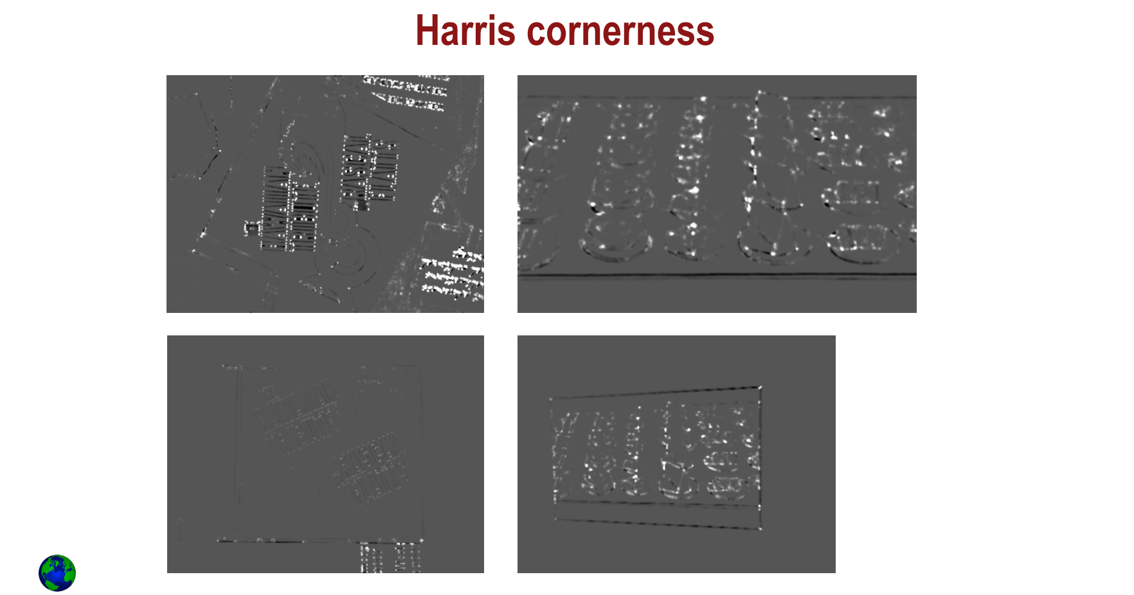
Lecture 11 – Key-point Detection
Image Processing: Dr. Nguyen Ngoc Truong Minh, @2024-2025 International University

Slide 22
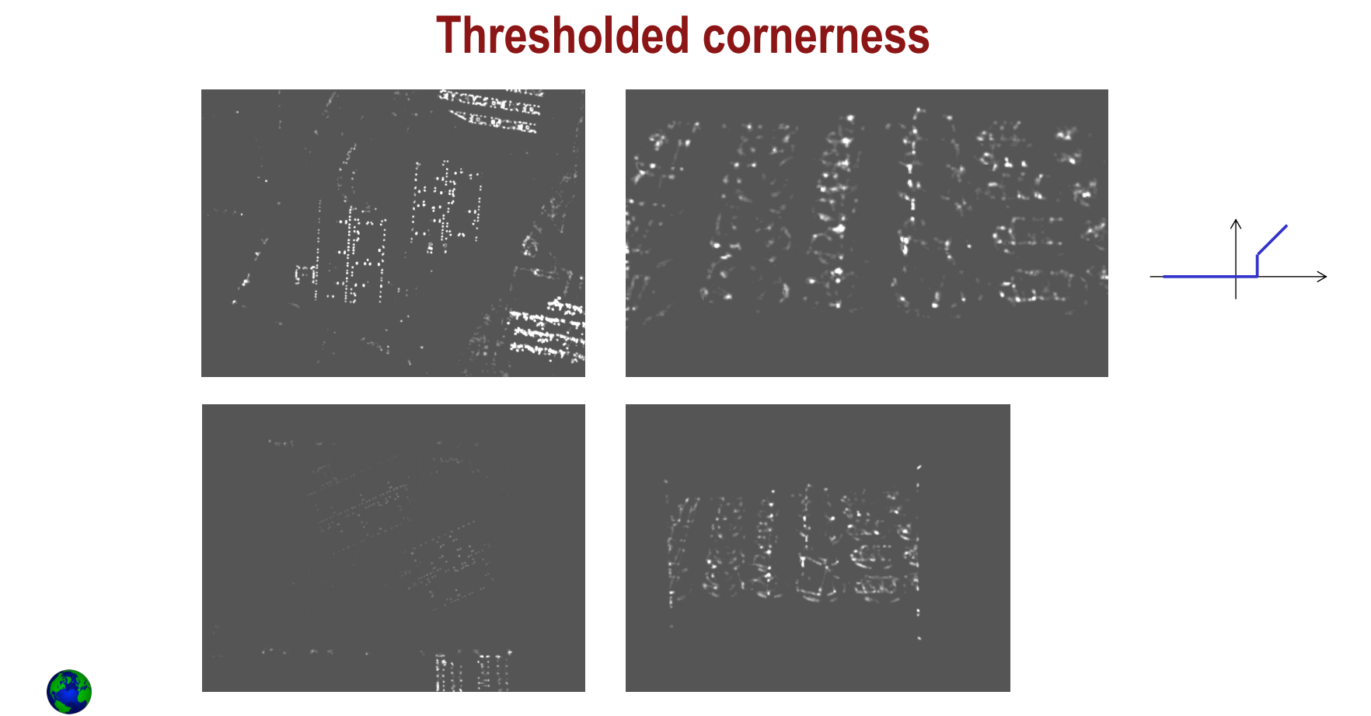
Lecture 11 – Key-point Detection
Image Processing: Dr. Nguyen Ngoc Truong Minh, @2024-2025 International University

Slide 23
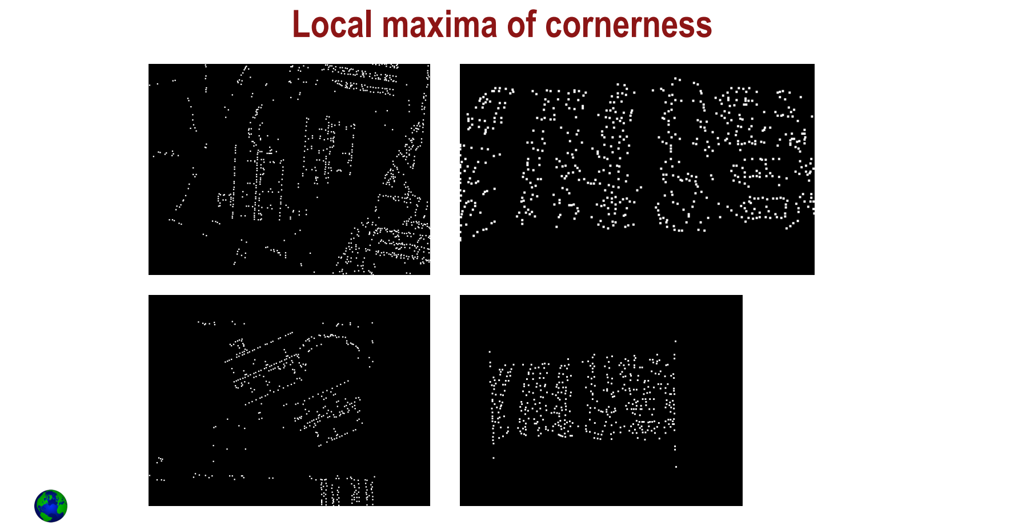
Lecture 11 – Key-point Detection
Image Processing: Dr. Nguyen Ngoc Truong Minh, @2024-2025 International University

Slide 24
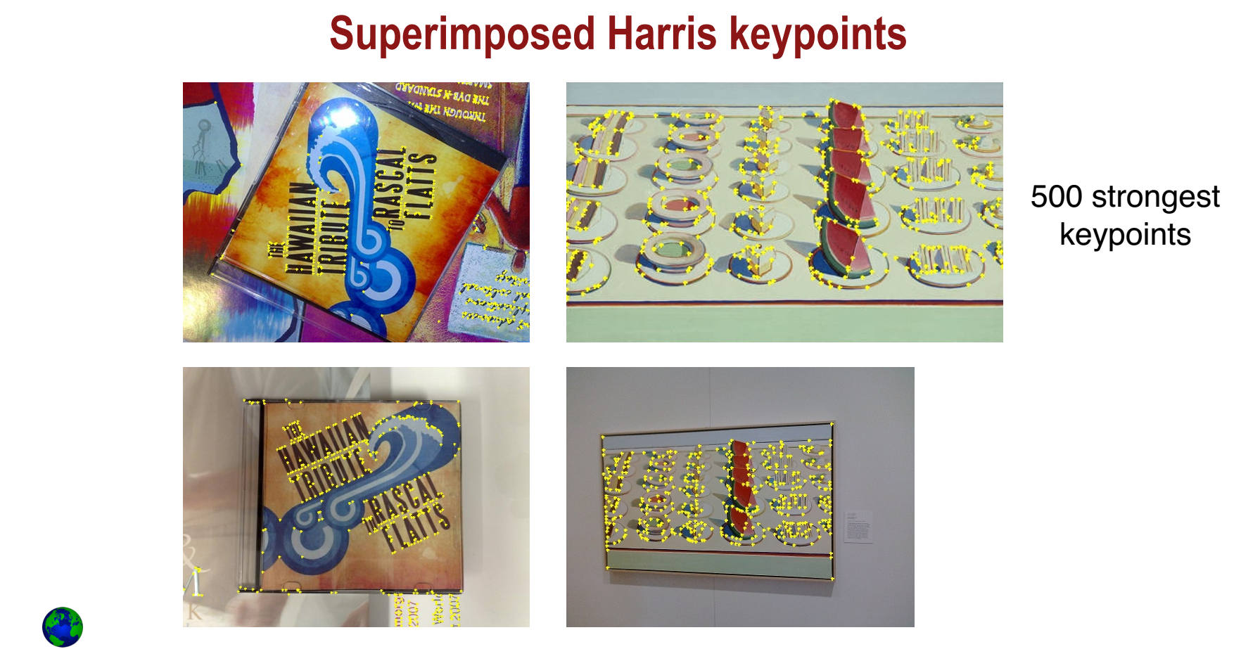
Lecture 11 – Key-point Detection
Image Processing: Dr. Nguyen Ngoc Truong Minh, @2024-2025 International University

Slide 25
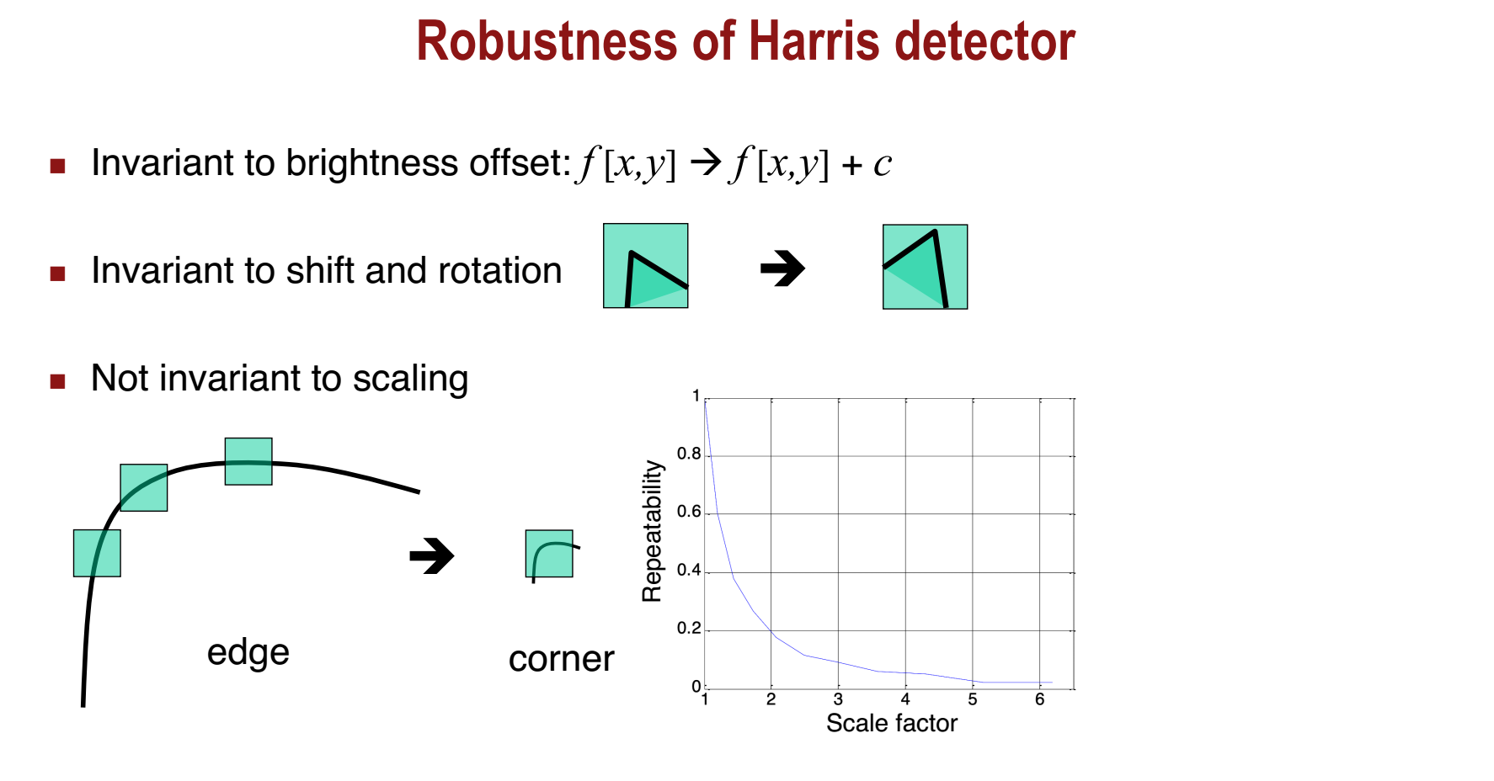
Lecture 11 – Key-point Detection
Image Processing: Dr. Nguyen Ngoc Truong Minh, @2024-2025 International University

Slide 26
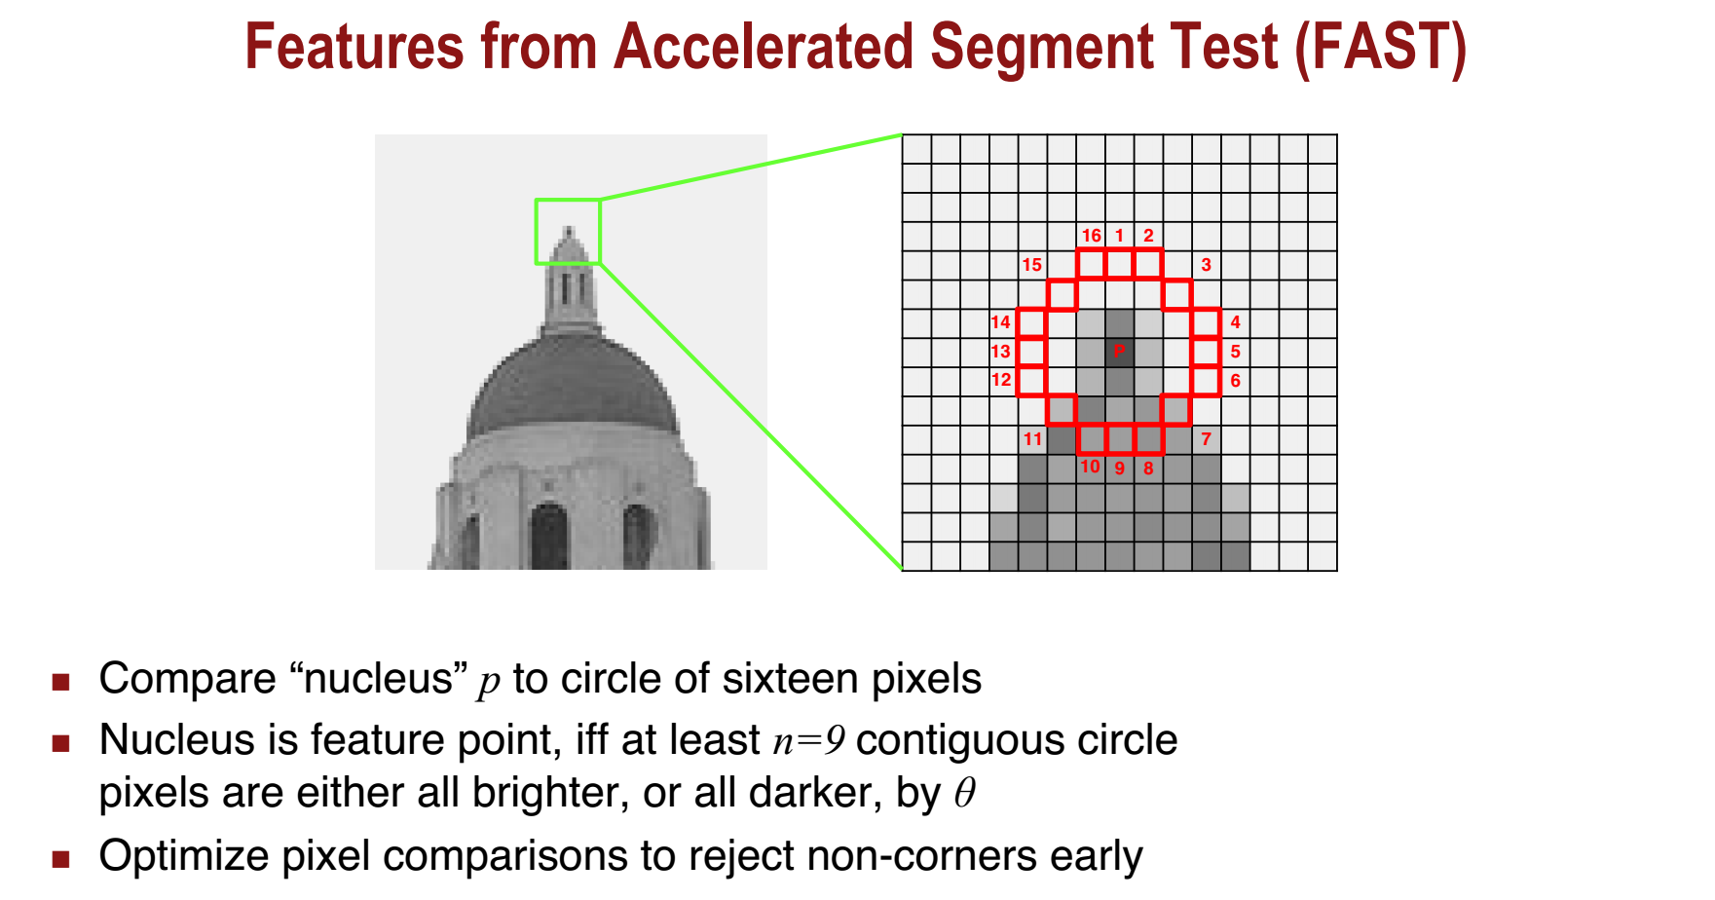
Lecture 11 – Key-point Detection
Image Processing: Dr. Nguyen Ngoc Truong Minh, @2024-2025 International University

Slide 27

Lecture 11 – Key-point Detection
Image Processing: Dr. Nguyen Ngoc Truong Minh, @2024-2025 International University

Slide 28
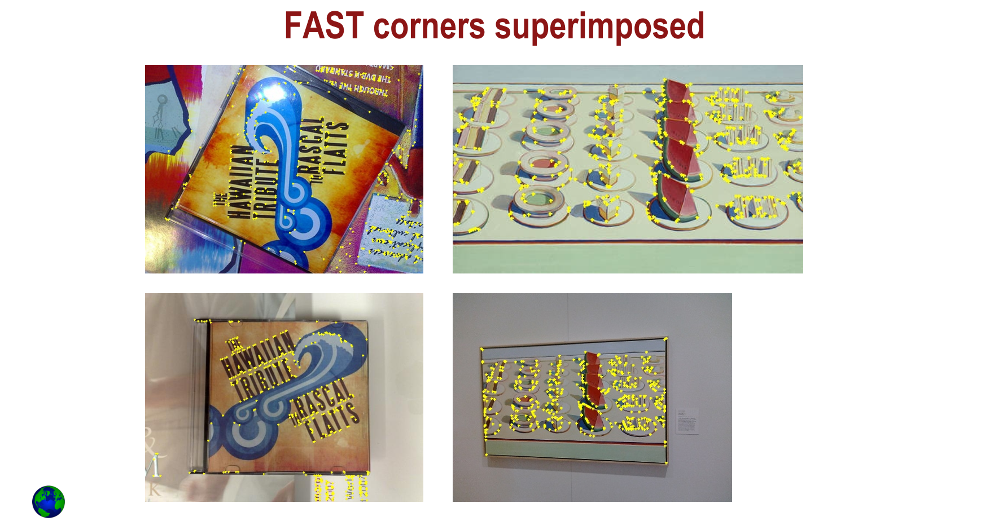
Lecture 11 – Key-point Detection
Image Processing: Dr. Nguyen Ngoc Truong Minh, @2024-2025 International University

Slide 29
Lecture 11 – Key-point Detection
FAST corner detection on smartphone
https://www.youtube.com/watch?v=Z_HwkG90Yvw
Image Processing: Dr. Nguyen Ngoc Truong Minh, @2024-2025 International University

Slide 30
Lecture 11 – Key-point Detection
FAST keypoint tracking on smartphone
https://www.youtube.com/watch?v=L7jbcOf5rDA
Image Processing: Dr. Nguyen Ngoc Truong Minh, @2024-2025 International University

Slide 31
END OF LECTURE 11
LECTURE 12 – INTRODUCTION TO SPEECH PROCESSING

